Slide 1

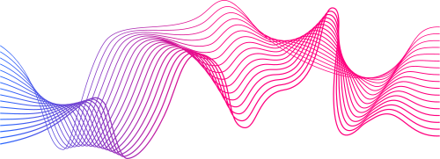
IMAGE PROCESSING USING DFT
PRESENTED BY
Anjanay Khare (RA2011032010007)
Paras Sharma (RA2011032010049)
Vinay Poddar (RA2011032010061)

Slide 2

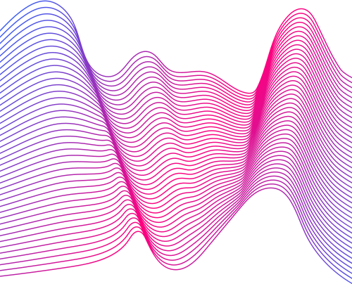
1
Abstract
2
Objective
INDEX
3
How it Works
4
Algorithm Used

Slide 3
Abstract

Slide 4
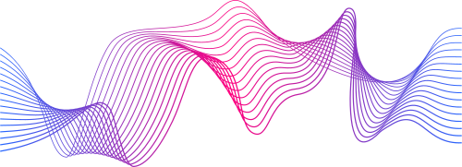
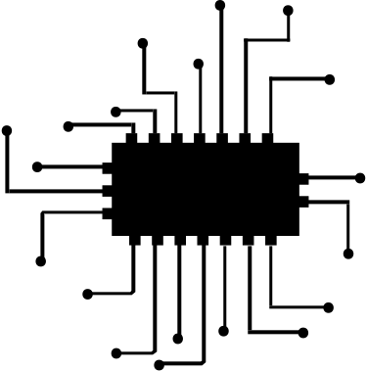
Image processing is defined as the process of analysing and manipulating images on a computer. In digital image processing, variety of algorithms can be processed to an input image and the output image can be rendered more attractive to viewers by using the methods of image processing. The image processing system usually treats all images as 2D signals when applying certain predetermined signal processing methods.
Digital Image Processing is the process of a digital images by use of digital computers through an algorithm.

Slide 5
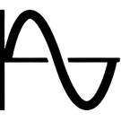
The Fourier Transform is an important image processing tool which is used to decompose an image into its sine and cosine components. The output of the transformation represents the image in the Fourier or frequency domain, while the input image is the spatial domain equivalent.
In the Fourier domain image, each point represents a particular frequency contained in the spatial domain image. The Fourier Transform is used in a wide range of applications, such as image analysis, image filtering, image reconstruction and image compression.
The Fourier transform is a representation of an image as a sum of complex exponentials of varying magnitudes, frequencies, and phases.

Slide 6
The DFT is one of the most powerful tools in digital signal processing which enables us to find the spectrum of a finite-duration signal. The DFT is used to convert an image from the spatial domain into frequency domain, in other words it allows us to separate high frequency from low frequency coefficients and neglect or alter specific frequencies leading to an image with less information but still with a convenient level of quality.
The foundation of the product is the fast Fourier transform (FFT), a method for computing the DFT with reduced execution time
The discrete time Fourier transform is a mathematical tool which is used to convert a discrete time sequence into the frequency domain.

Slide 7
Objective

Slide 8
1 | Transform an image into digital form and perform certain operations on it in order to obtain specific models or to extract useful information from the image.
2 | Remove unwanted frequencies (such as noise) from an image by applying a filter in the frequency domain.
3 | Reduce its size without significantly affecting its visual quality.
4 | Enhance certain features of an image by selectively amplifying or attenuating specific frequency components.
5 | Identify patterns or similarities between different images.
Objectives

Slide 9
How it Works

Slide 10
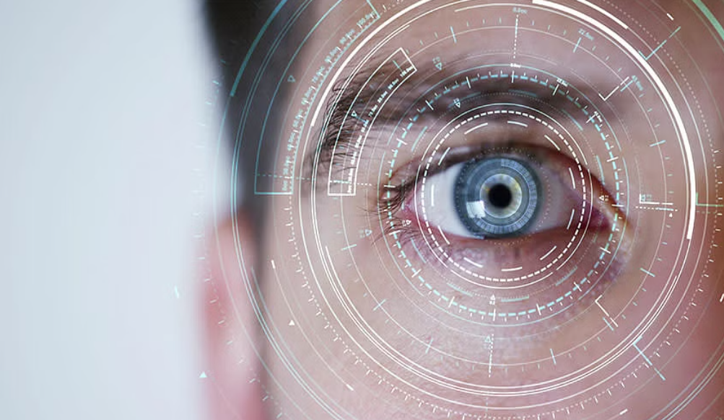
The DFT is the sampled Fourier Transform and therefore does not contain all frequencies forming an image, but only a set of samples which is large enough to fully describe the spatial domain image.
The number of frequencies corresponds to the number of pixels in the spatial domain image, i.e. the image in the spatial and Fourier domain are of the same size.
A discrete transform is a transform whose input and output values are discrete samples, making it convenient for computer manipulation.

Slide 11



For a square image of size N×N, the two-dimensional DFT is given by:
where f(a,b) is the image in the spatial domain and the exponential term is the basis function corresponding to each point F(k,l) in the Fourier space.
The equation can be interpreted as: the value of each point F(k,l) is obtained by multiplying the spatial image with the corresponding base function and summing the result.

Slide 12

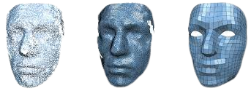
The basis functions are sine and cosine waves with increasing frequencies, i.e. F(0,0) represents the DC-component of the image which corresponds to the average brightness and F(N-1,N-1) represents the highest frequency.
In a similar way, the Fourier image can be re-transformed to the spatial domain. The inverse Fourier transform is given by:

Slide 13


To obtain the result for the above equations, a double sum has to be calculated for each image point.
However, because the Fourier Transform is separable, it can be written as
where
Using these two formulas, the spatial domain image is first transformed into an intermediate image using N one-dimensional Fourier Transforms.
This intermediate image is then transformed into the final image, again using N one-dimensional Fourier Transforms.

Slide 14
Algorithm Used

Slide 15

The FFT is a fast algorithm for computing the DFT. If we take the 2-point DFT and 4-point DFT and generalize them to 8-point, 16-point, ..., 2r -point, we get the FFT algorithm.
To compute the DFT of an N-point sequence using equation
would take O(N^2 ) multiplies and adds. The FFT algorithm computes the DFT using O(N log N) multiplies and adds.
A fast Fourier transform (FFT) is an algorithm that computes the discrete Fourier transform (DFT) of a sequence, or its inverse (IDFT).

Slide 16
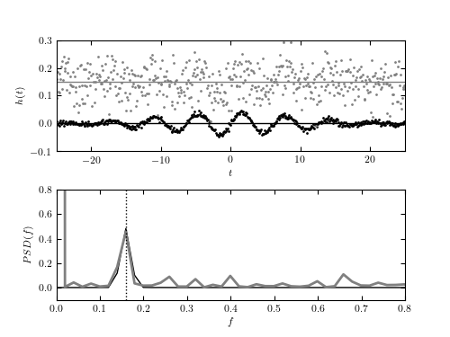
In complex notation, the time and frequency domains each contain one signal made up of N complex points.
Each of these complex points is composed of two numbers, the real part and the imaginary part.
The FFT operates by decomposing an N point time domain signal into N time domain signals each composed of a single point.
The second step is to calculate the N frequency spectra corresponding to these N time domain signals. Lastly, the N spectra are synthesized into a single frequency spectrum.

Slide 17
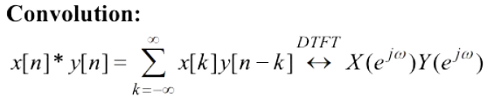
The application of the Fourier Transform isn’t limited to digital signal processing. The Fourier Transform can, in fact, speed up the training process of convolutional neural networks.
The Fourier Transform can speed up convolutions by taking advantage of the following property.
Fast Fourier transform (FFT) is used in designing electrical circuits, solving differential equations, signal processing, signal analysis, image processing & filtering.

Slide 18
Thank You

